Slide 1
Statistics Assignment 1
Multivariate Analysis
Subhrajyoty Roy
Roll- BS-1613

Slide 2
About the Data
The Dataset is taken from a university in USA, where all the students are taken from a chemical engineering course.
I have collected it from www.openmv.net .
There are six variables in the dataset. The predictors are respectively High School GPA (as mentioned while applying to the university), Assignment grades, Performance in Homework and Tutorial classes and Midterm scores, while we try to regress their scores in Final examination of first year in the college.
Total number of students in 95.
All the scores have been scaled to out of full marks 100.

Slide 3
Bivariate Analysis
Variables | School GPA | Assignment | Tutorial | Midterm | Homework
Assignment | 0.0484
Tutorial | 0.4345 | 0.4590
Midterm | -0.0586 | 0.2007 | 0.1486
Homework | -0.0689 | 0.4832 | 0.2381 | 0.4271
Final | 0.0881 | 0.2863 | 0.2398 | 0.7244 | 0.4742
Observe that School GPA has very little effect on the scores of Final examination. This is somewhat surprising that the high school performance students get is not highly positively correlated with final scores in next year in college.
Some variables are moderately correlated with each other, implying we should not expect a very high multiple correlation coefficient.

Slide 4
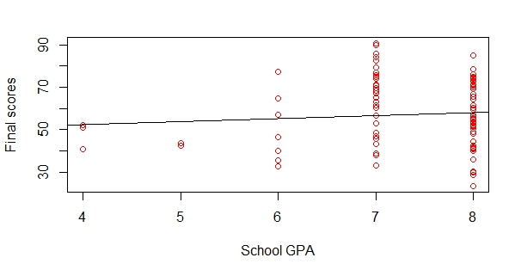
Why School GPA not a good measure for Final scores?

Slide 5
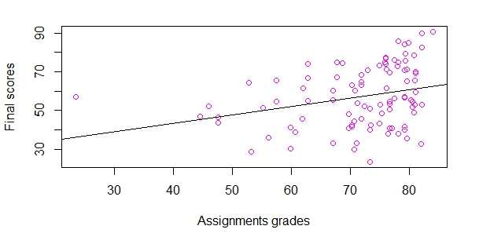
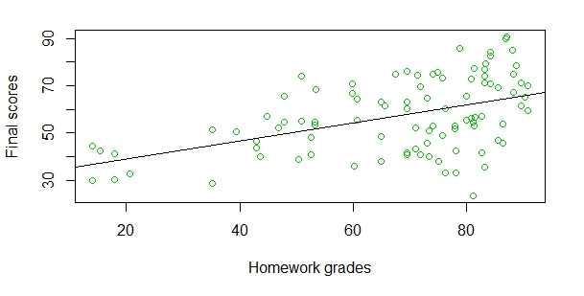
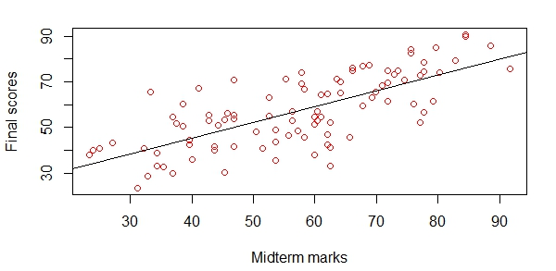
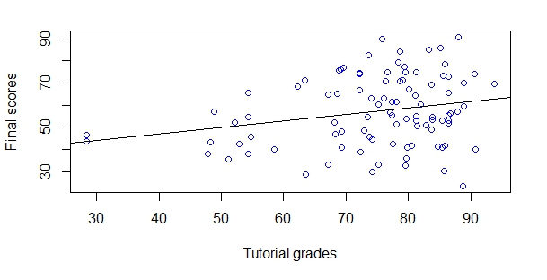
A Few Scatter plots

Slide 6
The Nearly Ideal Multivariate Analysis
In this section, according to the theory assumptions of linear multivariate models, I have generated independently 100 observations of 4 variable each.
Errors are generated from the normal distribution N(0, 5²).
Variables | Y | X1 | X2 | X3 | X4
X1 | 0.5817
X2 | 0.3316 | 0.0790
X3 | 0.8568 | 0.0236 | 0.00075
X4 | 0.0589 | 0.0538 | 0.0387 | 0.0201
e | 0.2876 | 0.0359 | 0.1028 | 0.1446 | 0.0677

Slide 7
The Nearly Ideal Multivariate Analysis
Even if the ideal situation is assumed, I have called it “Nearly Ideal” as the independent variables i.e. the predictors are not completely independent, as they are generated using a deterministic algorithm with the similar amount of entropy generated by the computer.
The multiple regression equation comes out to be; Y = -1.3572 + 0.9971 x1 +1.0481 x2 + 1.0264 x3 + 5.9080 x4.
Multiple R squared: 0.9821
Adjusted R squared: 0.9814
Partial Correlation:
Partial Correlation | X1 | X2 | X3 | X4
Y | 0.949249 | 0.912678 | 0.984453 | 0.074781

Slide 8
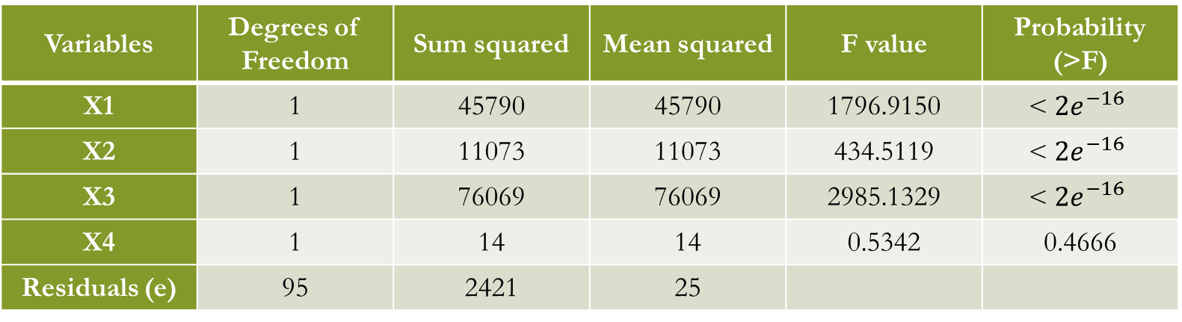
Analysis of Variance (Ideal)
Variables | Degrees of Freedom | Sum squared | Mean squared | F value | Probability (>F)
X1 | 1 | 45790 | 45790 | 1796.9150 | < $2e^{−16}$
X2 | 1 | 11073 | 11073 | 434.5119 | < $2e^{−16}$
X3 | 1 | 76069 | 76069 | 2985.1329 | < $2e^{−16}$
X4 | 1 | 14 | 14 | 0.5342 | 0.4666
Residuals (e) | 95 | 2421 | 25
Variables | Degrees of Freedom | Sum squared | Mean squared
Regression | 4 | 132946 | 33236.5
Residuals | 95 | 2421 | 25
Total | 99 | 135367
F statistic = 1304
Residual standard error = 5.048

Slide 9
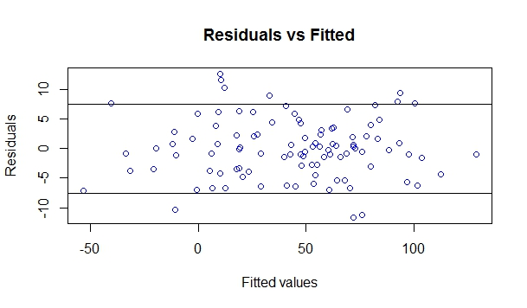
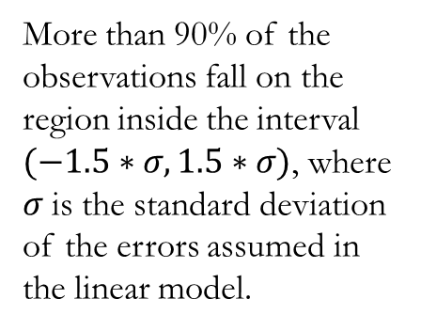
Residual Plot
More than 90% of the observations fall on the region inside the interval $(−1.5∗σ, 1.5∗σ)$, where $σ$ is the standard deviation of the errors assumed in the linear model.

Slide 10
Multivariate Analysis of the Dataset
The regression equation comes out to be:
Final = -11.36494 + 2.10736* School GPA + 0.08453* Assignment + 0.02727* Tutorial + 0.61906* Midterm + 0.14182* Homework
Multiple R squared: 0.5811
Adjusted R squared: 0.5576
F statistic: 24.7 (Low comparative to the ideal scenario, implying the fit is not so good).
Residual Standard Error: 10.45 (on 89 d.f.)

Slide 11
Summary of regression model
Coefficients:
Estimate Std. Error t value Pr(>|t|)
(Intercept) -11.36494 11.42154 -0.995 0.3224
School GPA 2.10736 1.31517 1.602 0.1126
Assignment 0.08453 0.13033 0.649 0.5183
Tutorial 0.02727 0.10807 0.252 0.8014
Midterm 0.61906 0.07348 8.425 5.8e⁻¹³
Homework 0.14182 0.06860 2.067 0.0416

Slide 12
Partial Correlation and effects
Partial Correlation | School GPA | Assignments | Tutorial | Midterm | Homework
Final Scores | 0.16745 | 0.06859 | 0.02673 | 0.66610 | 0.21405
From the Bivariate Analysis, it was found that these factors moderately determines the final scores as the simple product-moment correlation coefficient is found to be moderately high.
But, Here’s the catch! They are so much inter-dependent among themselves that partial correlation comes out lesser than the simple correlation for most of the variables.
On the contrast, the School GPA, which was considered most insignificant previously, is found to have greater partial correlation than its simple product-moment correlation with Final scores.

Slide 13
ANOVA for the dataset
Variables | Degrees of Freedom | Sum squared | Mean squared | F value | Probability (>F)
School GPA | 1 | 180.5 | 180.5 | 1.6521 | 0.20201
Assignments | 1 | 1850.8 | 1850.8 | 16.9415 | 8.595e⁻⁵
Tutorial | 1 | 226.7 | 226.7 | 2.0752 | 0.15322
Midterm | 1 | 10765.7 | 10765.7 | 98.5434 | 4.533e⁻¹³
Homework | 1 | 466.7 | 466.7 | 4.2739 | 0.04161
Residuals (e) | 89 | 9723.1 | 109.2
Variables | Degrees of Freedom | Sum squared | Mean squared
Regression | 5 | 13490.4 | 2698.08
Residuals | 89 | 9723.1 | 109.24
Total | 94 | 23213.5

Slide 14
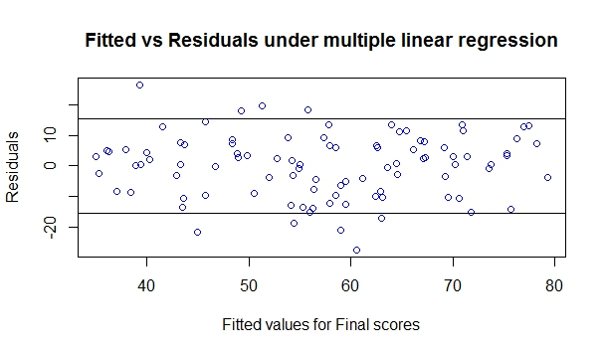
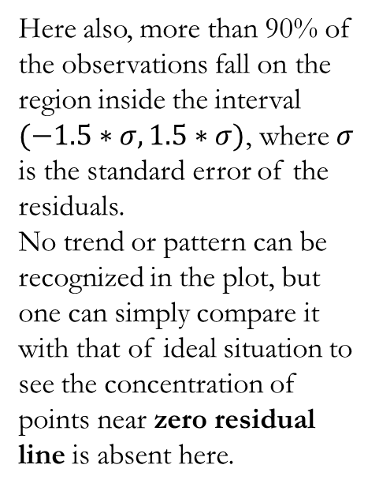
Residual Plot
Here also, more than 90% of the observations fall on the region inside the interval $(−1.5∗σ, 1.5∗σ)$, where $σ$ is the standard error of the residuals.
No trend or pattern can be recognized in the plot, but one can simply compare it with that of ideal situation to see the concentration of points near zero residual line is absent here.

Slide 15
Conclusion
Only bivariate analysis fails to give a correct picture of the relationship between two variables as they may be correlated to some other variables (confounding factors).
Residual standard error can be expected to be close to the actual errors assumed in the linear model.
The concentration of points in residual plot should be close to the line “residual = 0”, and the concentration should decrease as one goes away from the line (effectively showing the presence of normally distributed errors).

Slide 16

Thank You

